Slide 1
Weekly Meeting
July 19 2017

Slide 2
Toronto Youth Meeting
International summer camp
25 participants, 16-18 years old
13 countries represented: Austria, Canada, Columbia, Czech Republic, Denmark, Ecuador, France, Germany, Great Britain, Israel, Norway, Poland, Spain

Slide 3
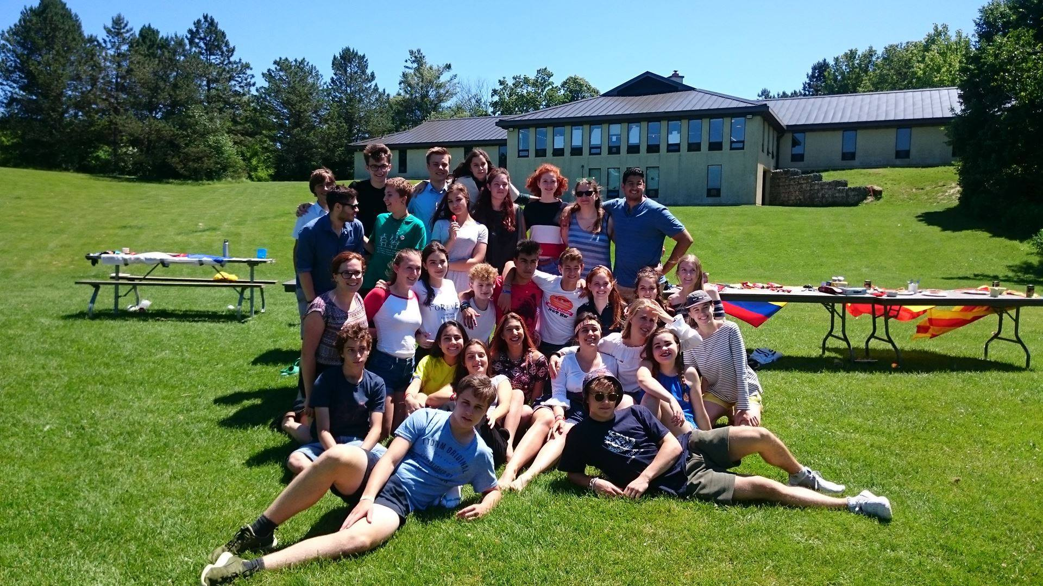
Toronto Youth Meeting

Slide 4
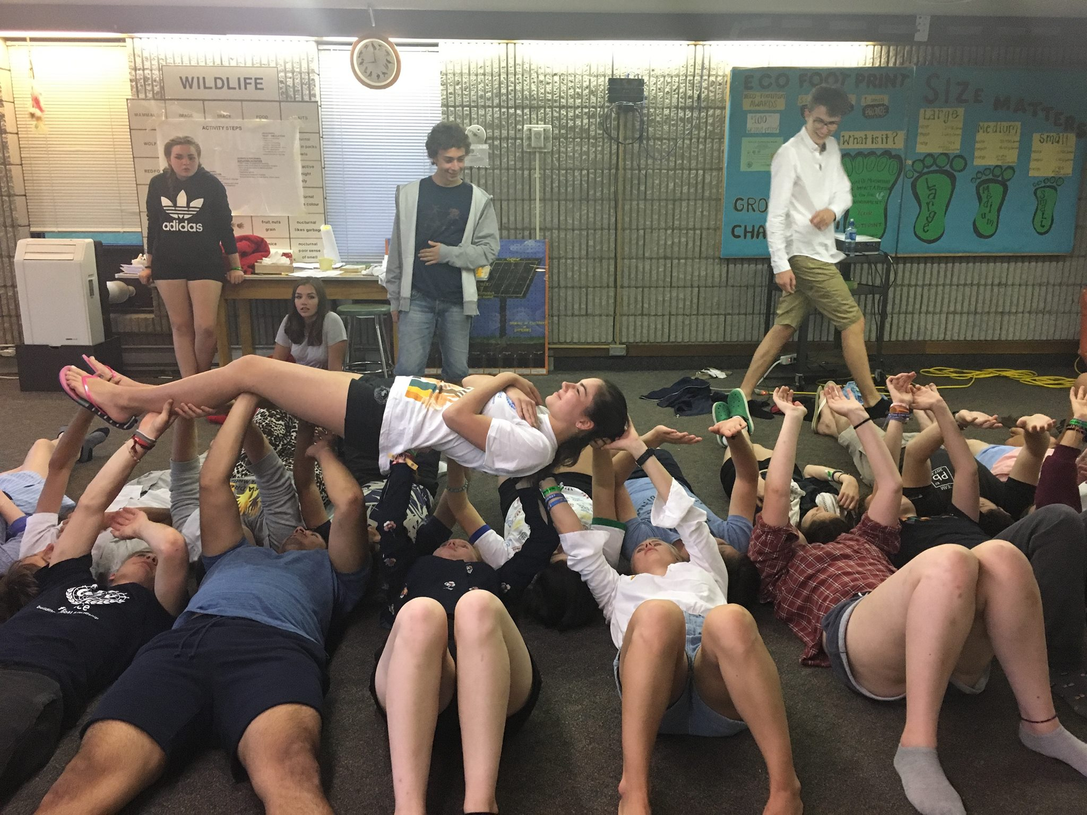
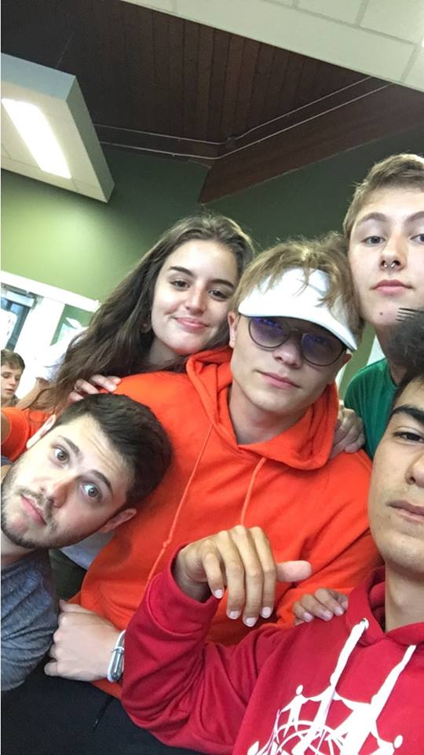
Toronto Youth Meeting

Slide 5
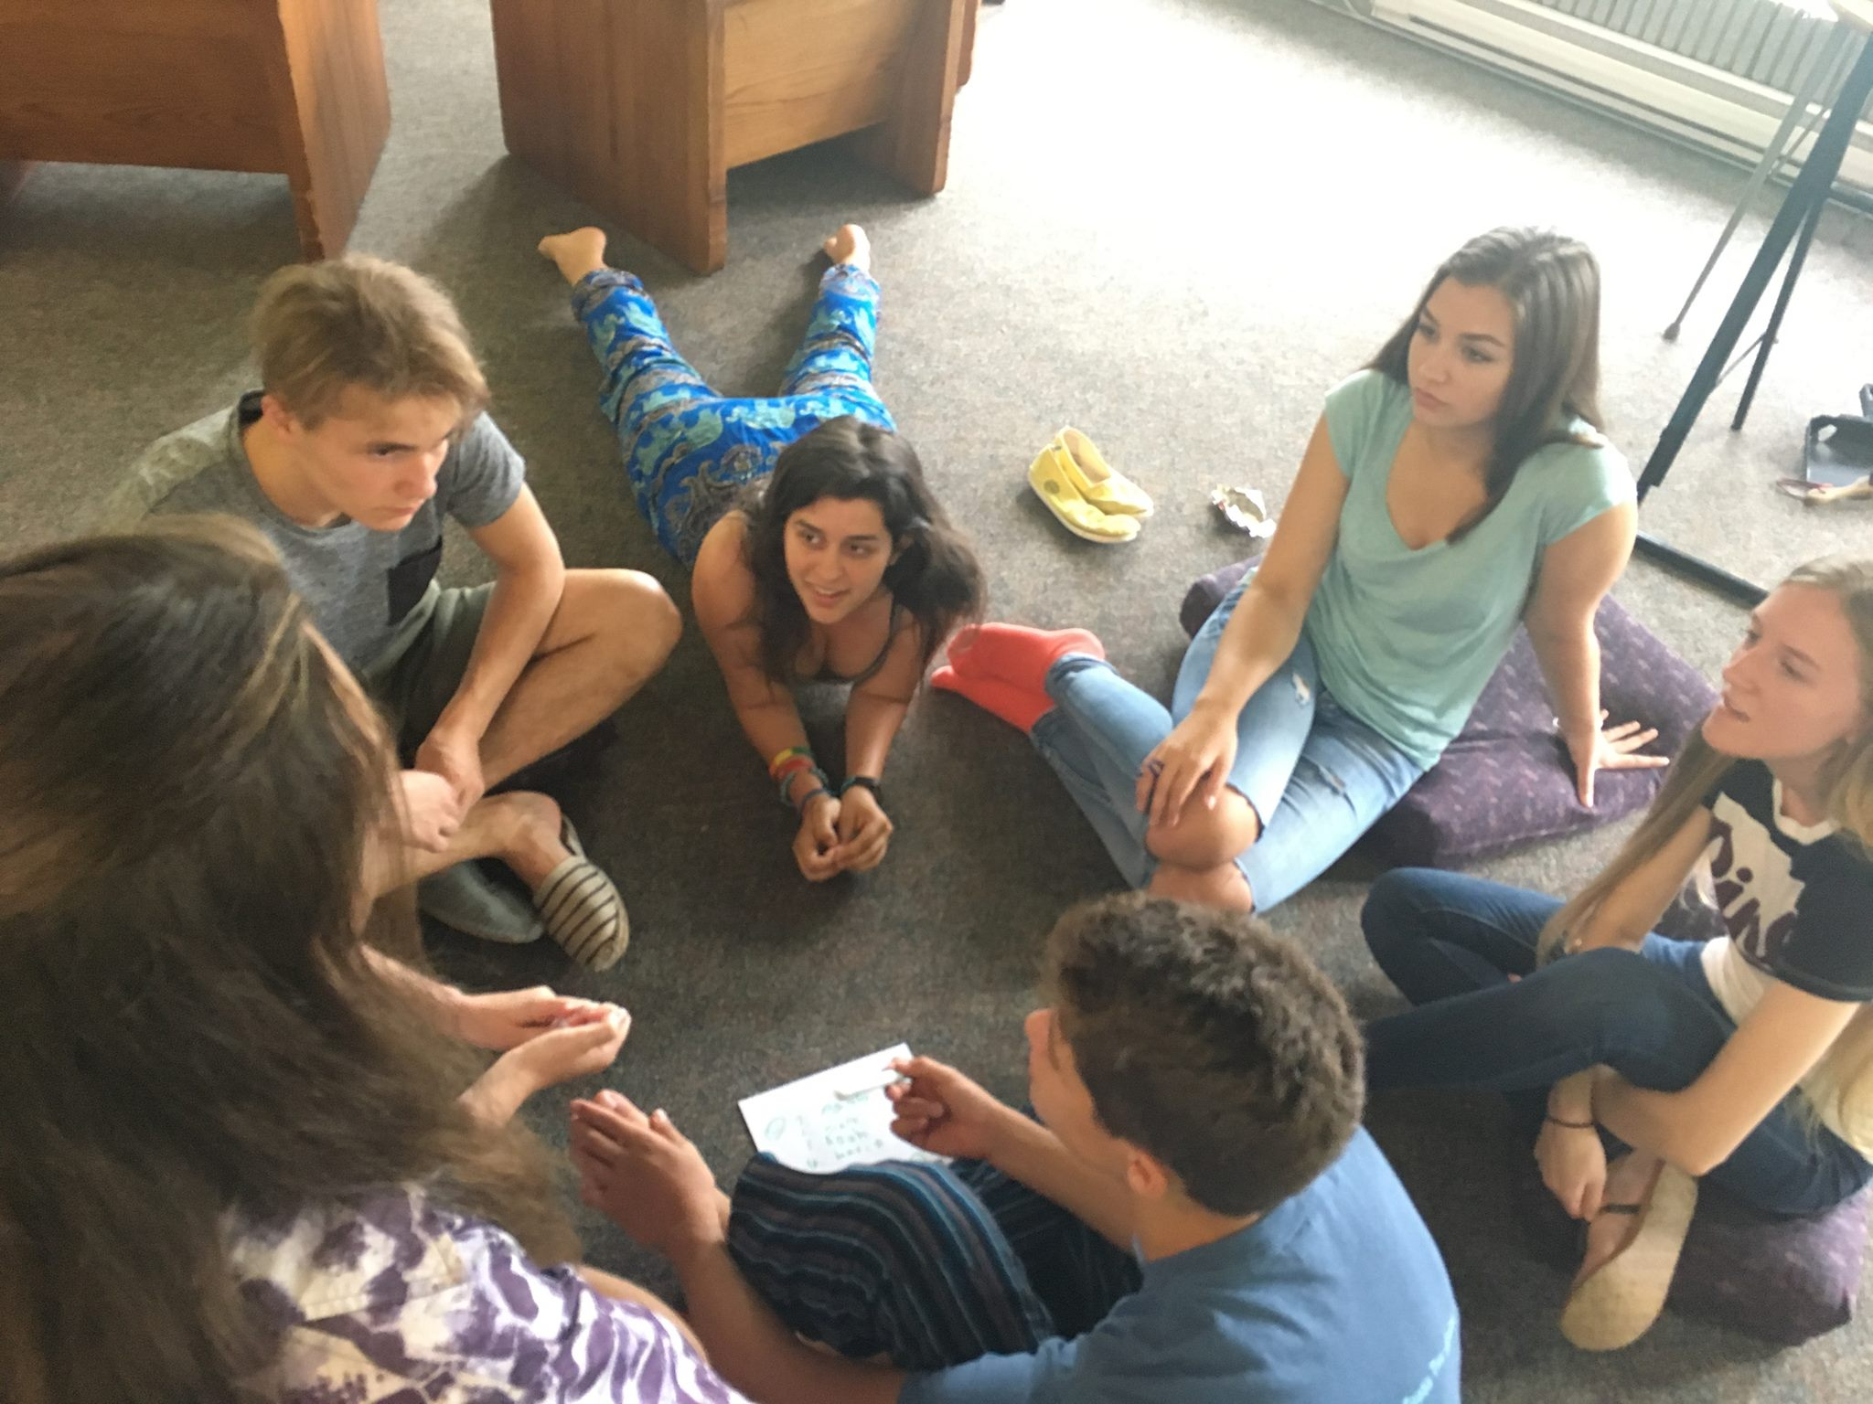
Toronto Youth Meeting

Slide 6
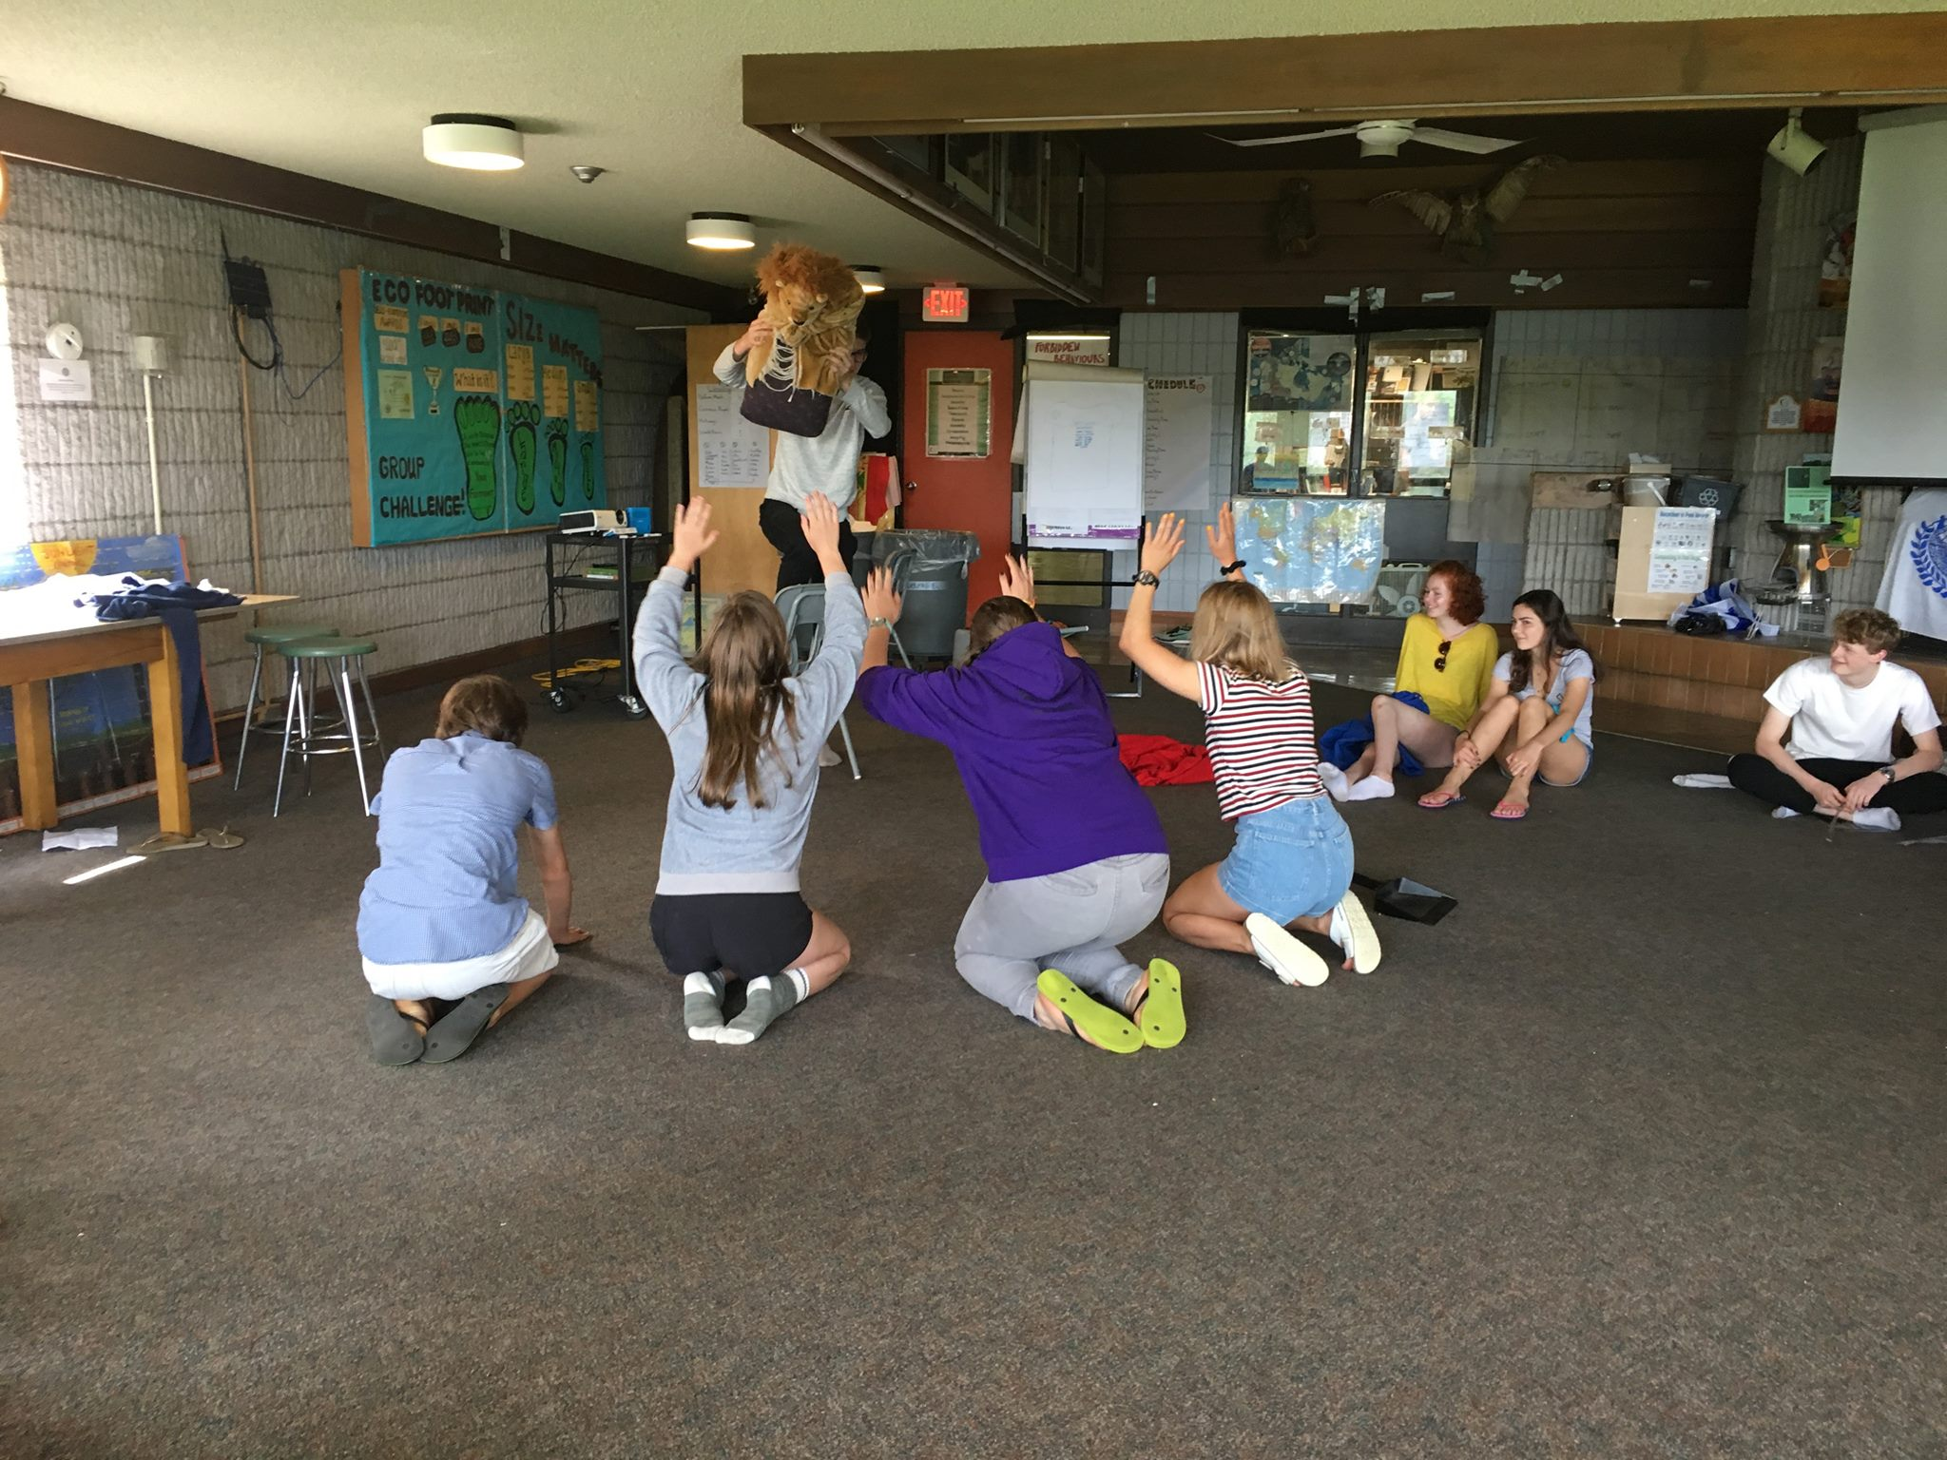
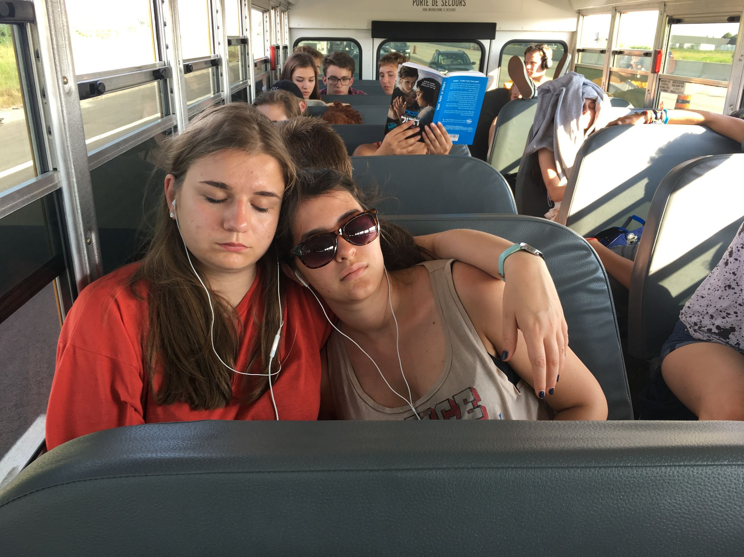
Toronto Youth Meeting

Slide 7
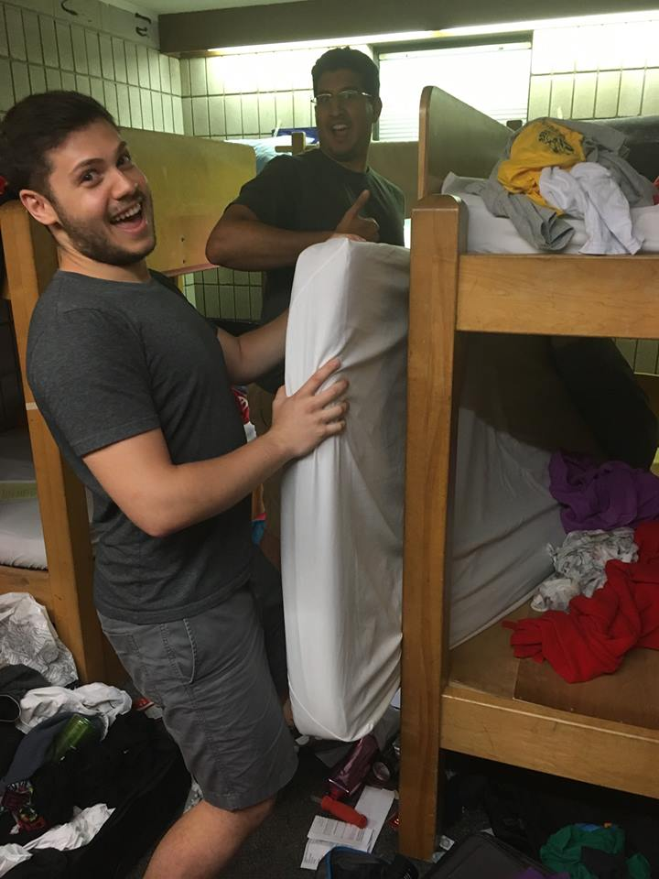
Toronto Youth Meeting

Slide 8
Update on IO Library, MIDAS…
UBC/TRIUMF coming up with rudimentary Event Builder
Event builder will use the IO Library
Still needs a bit of time before having the IO Library included in the DAQ entirely
Belina suggests having a meeting after this is accomplished
Still don’t have a sense about what MIDAS dependency the IO Library will have, if any

Slide 9
In the meantime…

Slide 10
DMC Data
I compared the data from the Soudan binary writer to the SNOLAB data format

Slide 11
DMC Data
Some of this data is written to file at another stage
E.g. QET Bias, SQUID Bias, are parameters in ODB, that are written out when ODB gets written out
Some data I’m not sure what it means
E.g. Data Major, Data Minor?
There is SNOLAB data that has no DMC equivalent, but I’m guessing some of this will be placeholders
E.g. DCRC serial num and version
Where is the DMC truth information? It doesn’t seem to be written out in this binary format.

Slide 12
C++/python extensions
Been working on getting a python script to import a c++ shared library.
Using SWIG to generate an extension/wrapper that python can read
I’ve been able to get a c++ extension to work with python using a simple example code that has mostly the same properties as the cdms_iolibrary.cxx/h code
Will continue to flesh out issues with example code, should make for easy implementation of extension of actual code.

