Slide 1
Meeting Presentation
Elizabeth Chen

Slide 2
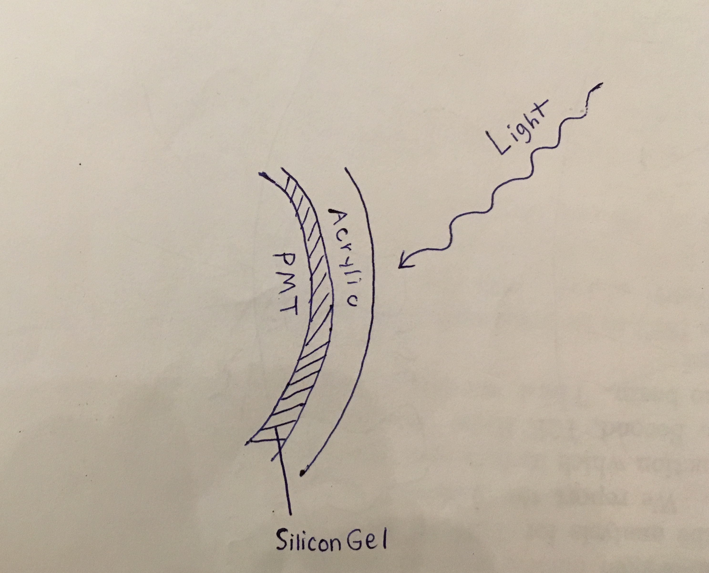
Background

Slide 3
Experimental Set-Up

Slide 4
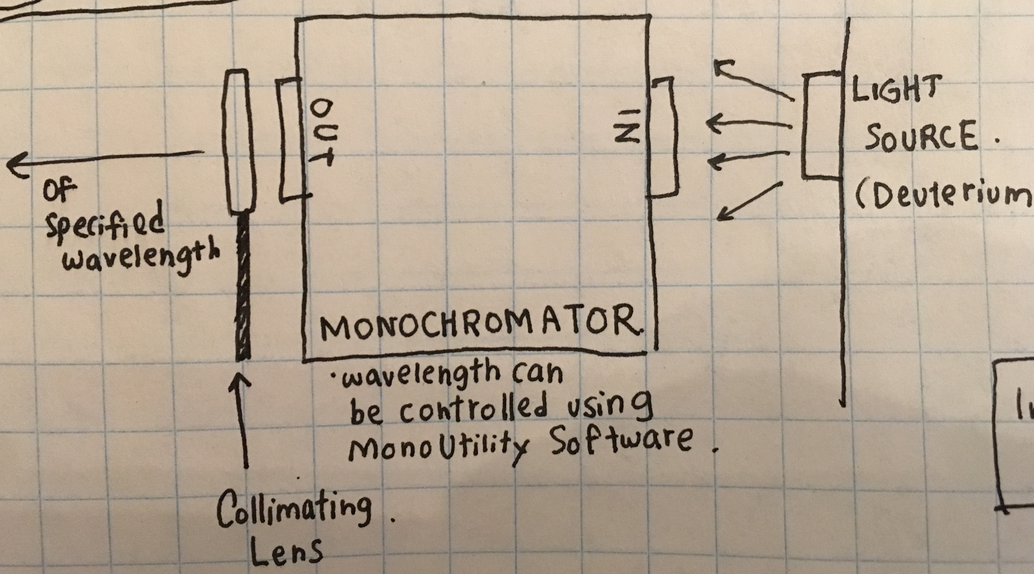

Slide 5
Where I’m at
Gathering parts and equipment
Familiarizing myself with devices
Building software interfaces for measuring instruments

Slide 6
Picoammeter Interface

Slide 7
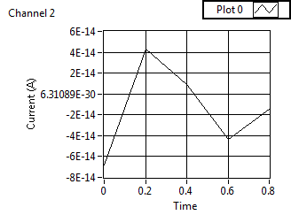

Slide 8
Monochromator and Camera Software

Slide 9
Next Steps
Set up equipment
Calibrate photodiode

