Slide 1
Big Bang Cosmology, Higgs Bosons and Genesis
Science and Judaism: A Research Workshop
The Institute for the History and Philosophy of Science and Technology
University of Toronto
28 March 2017
Pekka K. Sinervo, FRSC
Department of Physics

Slide 2
I’m going to summarize the current science that describes our universe, and reflect on Bereshit
Big Bang Cosmology
Higgs Boson – the “God Particle”
Connection with Bereshit
Some Personal Reflections

Slide 3
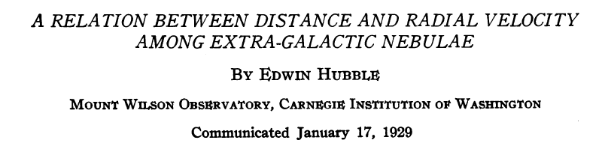
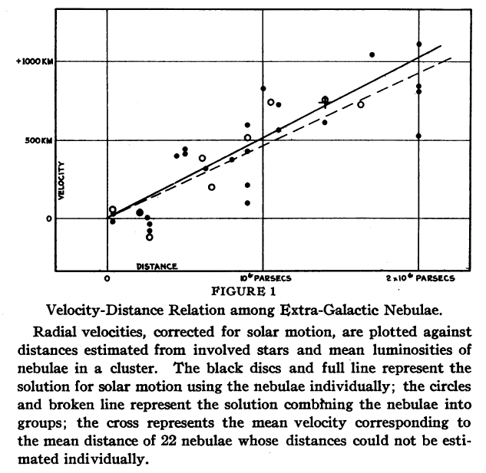
The universe was found to be expanding in 1920s
Expansion reported by Georges Lemaȋtre (1927) and then Edwin Hubble (1929), using Cepheid variable stars
All galaxies are receding from us with velocity
where
  H₀ is Hubble constant (~70 km/s/Mpc), and
  D is distance in Mpc
E. Hubble, PNAS 15 (3) 168 (1929).

Slide 4
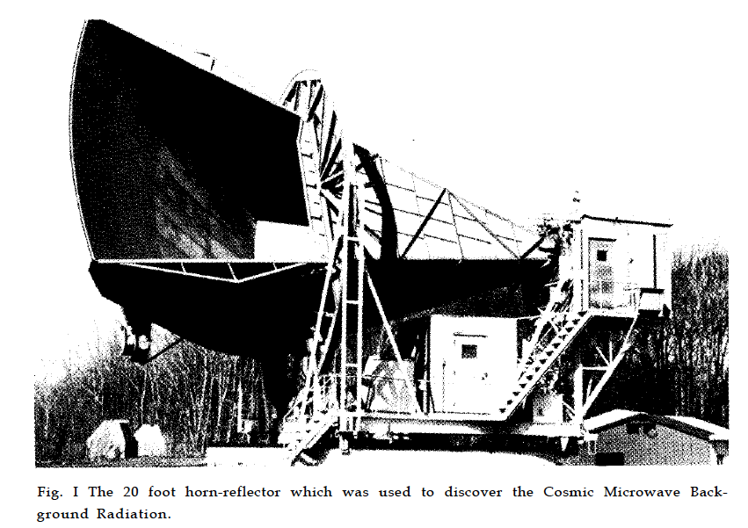
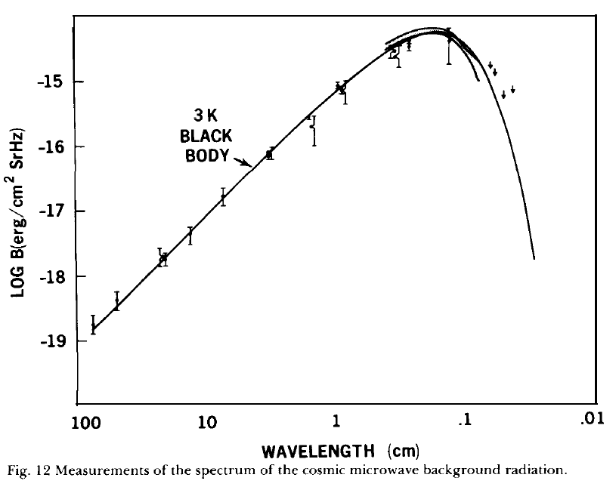
Cosmic microwave background radiation tells us what was taking place 370,000 years after Big Bang
Arno Penzias & Robert Wilson discovered “excess noise” at 21.1 cm wavelength
Readily interpreted as remnant from the early universe
Came at the moment neutral atoms could form, ~ 3,000º K
Identified as the CMB
R. WIlson, Nobel Lecture (1978).

Slide 5
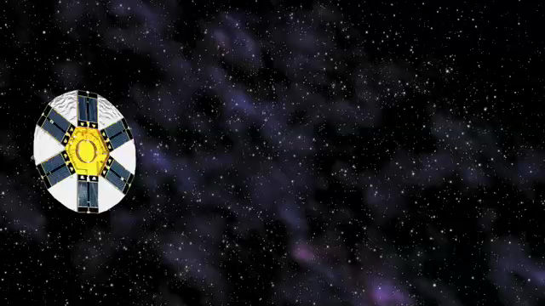
More recent measurements have been made by many experiments, with WMAP satellite the most recent
Courtesy NASA: https://map.gsfc.nasa.gov/media/030653/index.html

Slide 6
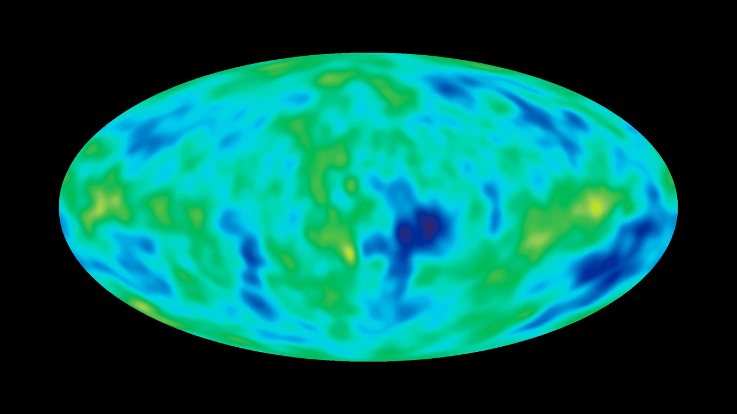
Over 20 years, CMB has come into clear focus
Courtesy NASA: https://map.gsfc.nasa.gov/media/030653/index.html

Slide 7
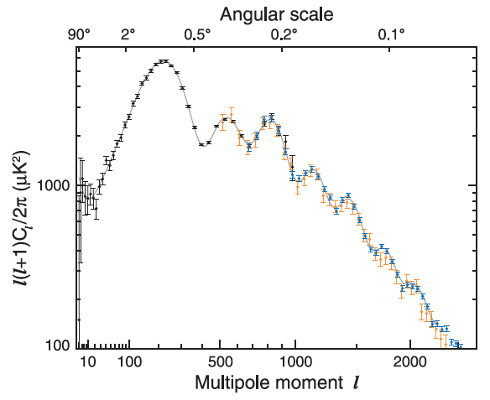
The angular size of the fluctuations tell us a great deal of what took place before the CMB was released
Location of first peak: Universe is flat
Height of 2nd peak:
Inflation model with lots of dark matter
Height of higher l peaks:
Direct measure of
dark matter density
Bennett, C.L., et al., 2013, ApJS., 208, 20B.

Slide 8
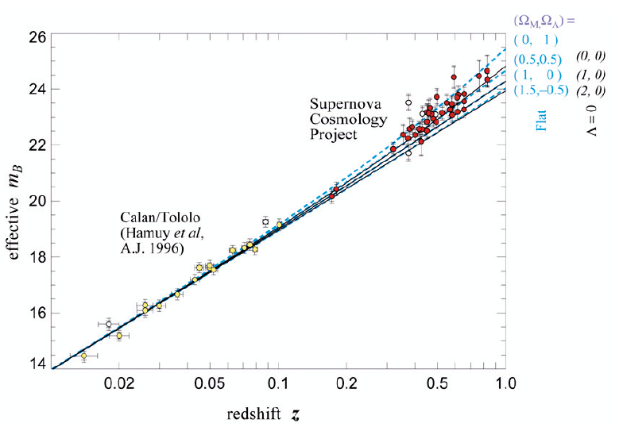
Detailed observations of galaxies show that the expansion is accelerating
Type 1a supernovae are a good measure of the expansion
Use relationship between apparent brightness, m_{B}, versus redshift z
S. Perlmutter, Rev. Mod. Phys. 84, 1127 (2012).

Slide 9
The supernovae at large redshifts reveal that our universe expansion is accelerating
Observations consistent with an expansion that is accelerating
Adam Riess, Brian Schmidt, Saul Perlmutter shared 2011 Nobel Prize in Physics

Slide 10
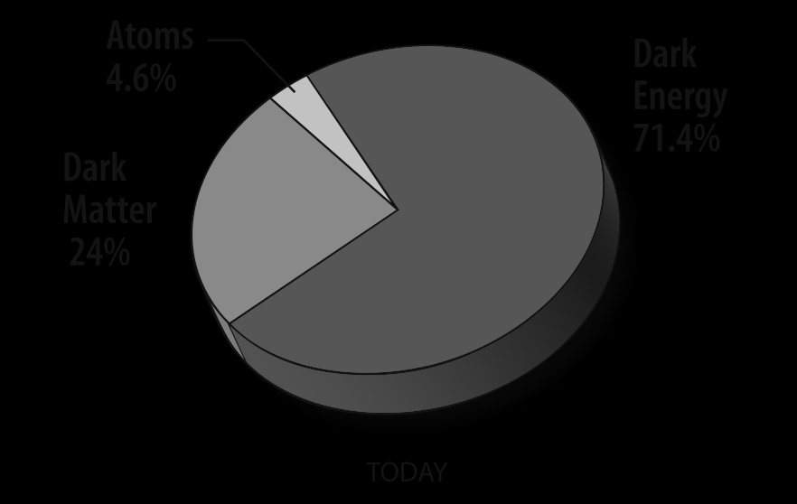
These cosmological data show that 95% of our universe is not ordinary matter
I’ve left out a host of observations, including
Galactic rotation curves
Dark matter lensing
Nucleosynthesis
Details about inflation
Matter-antimatter asymmetry

Slide 11
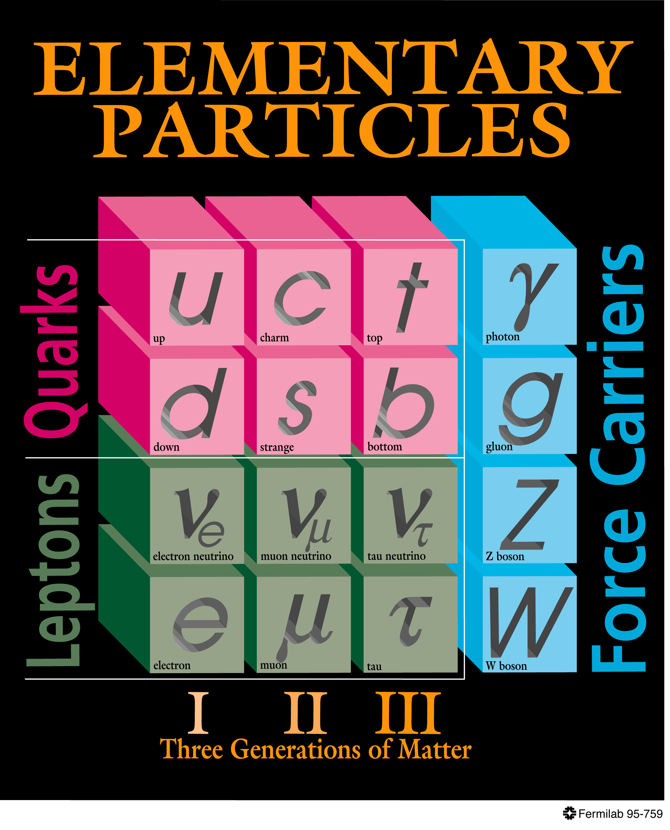
The development of the “Standard Model” of particle physics is a spectacular science success story
Predicted existence of
Top quark (1995)
Tau neutrino (2005)
The Higgs field
  and an associated particle

Slide 12
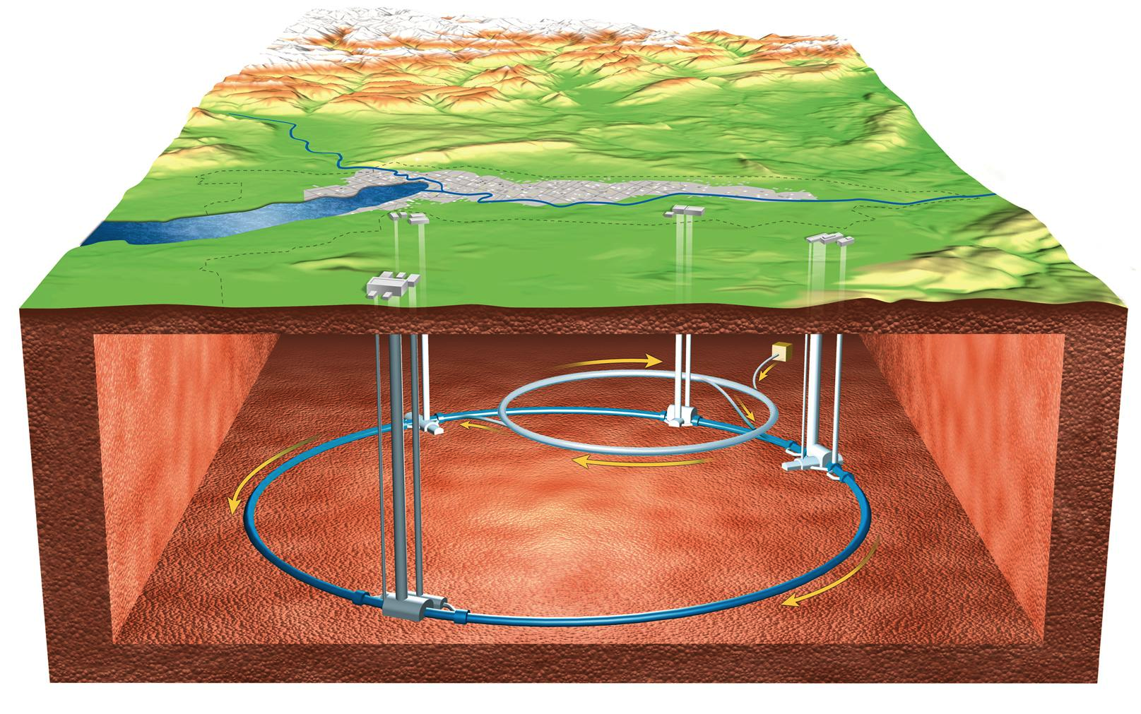
Search for these rare particles required us to recreate the conditions last seen briefly after the Big Bang
Large Hadron Collider to produce proton-proton collisions at an energy of 14 TeV
Equivalent to a temperature of ~10¹² degrees K
Takes us back to about 10⁻⁶ s after Big Bang

Slide 13
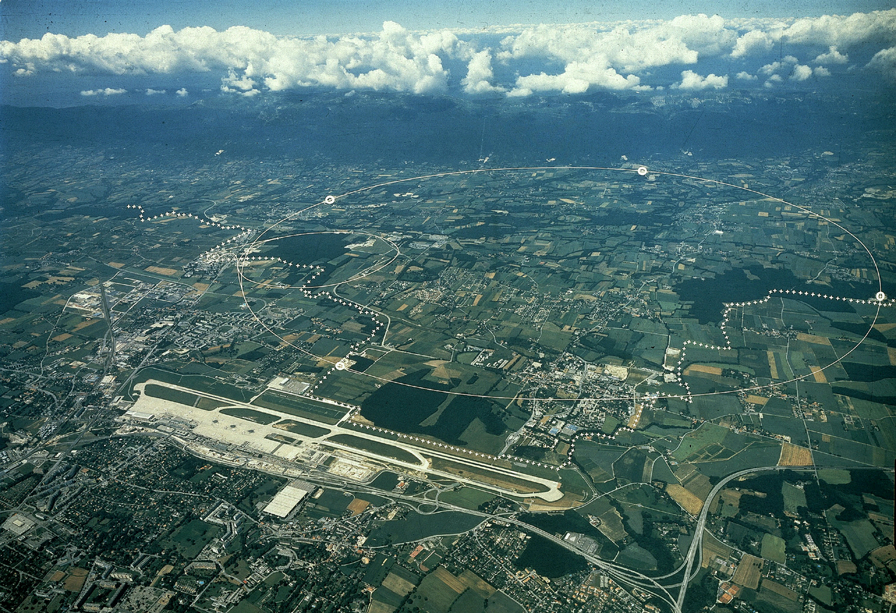

Slide 14
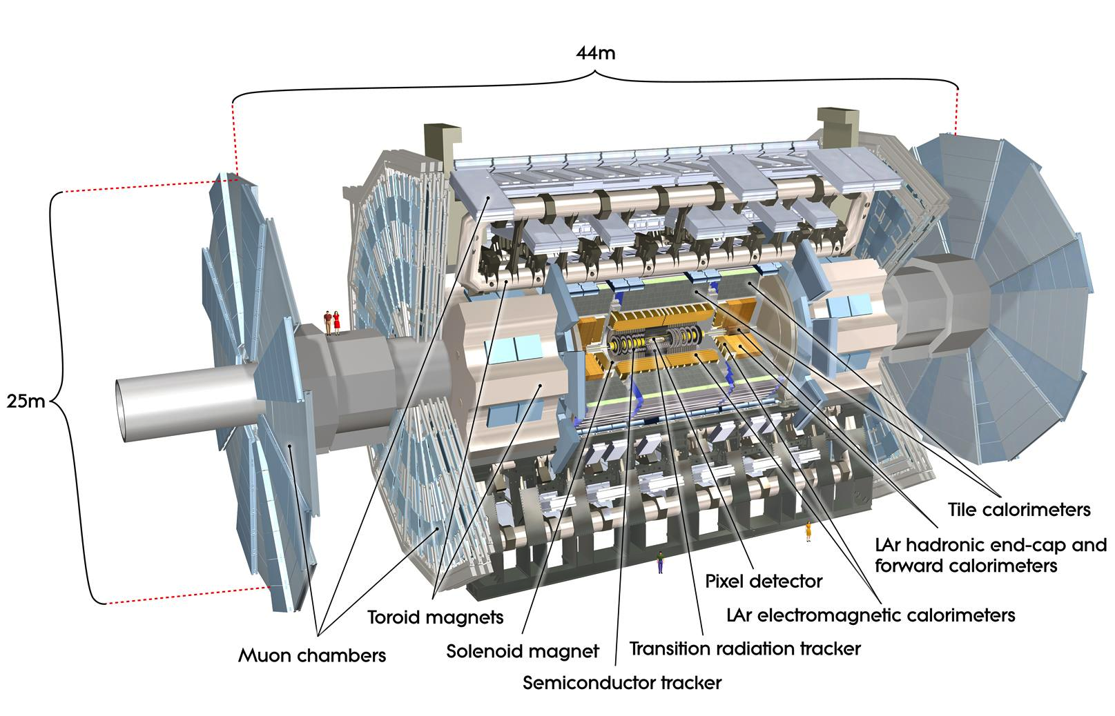
The collisions are observed with detectors that record all the debris created in each collision

Slide 15
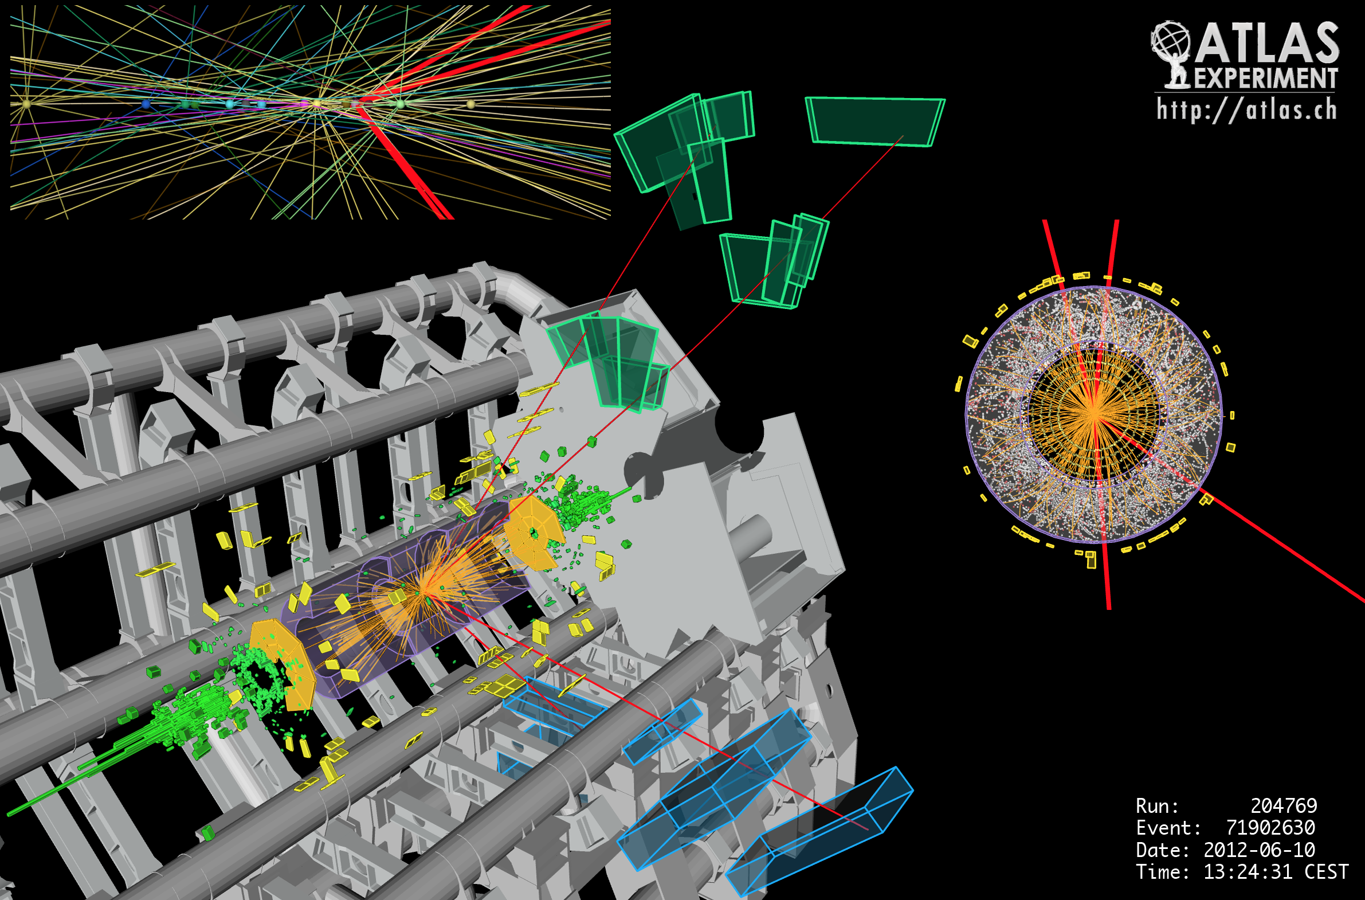

Slide 16

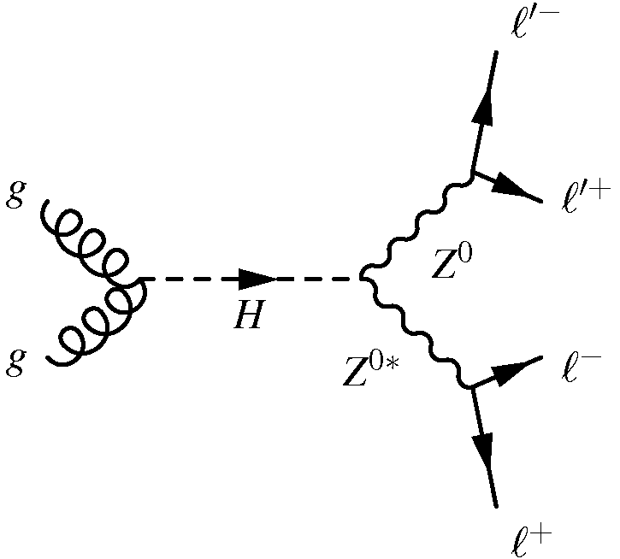
The experiments look for collisions where we see the decay products of a Higgs boson
One of the best modes to search for the Higgs boson is

Slide 17
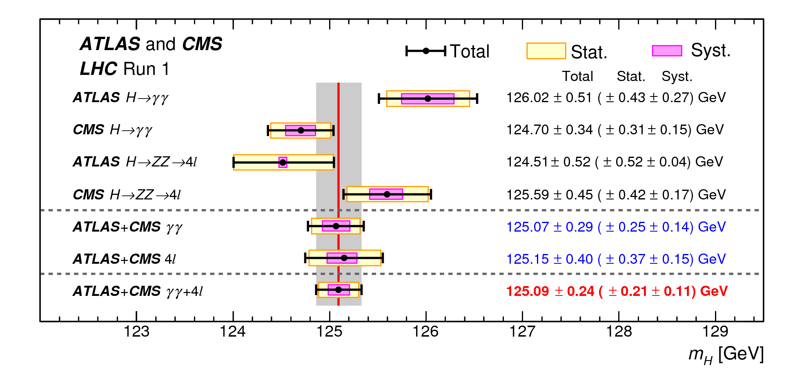
Discovery of Higgs boson made in 2012 by both the CMS and ATLAS experiments
Observed a particle with a mass of
125.09 ± 0.24 GeV
The ATLAS and CMS Collaborations, Phys. Rev. Lett. 114, 191803 (2012).

Slide 18
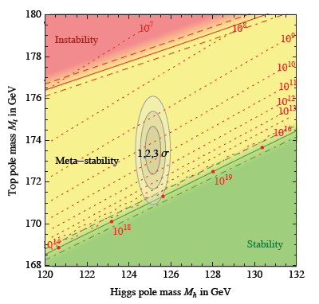
These “standard models” of cosmology and of particle physics have become the paradigm
Explain the phenomena observed
But big questions remain
What is Dark Matter
Why do we live in a matter-dominated universe?
What is Dark Energy?
Can gravity be understood as quantum field theory?
Is our Universe stable?
D. Buttazzo et al., JHEP (2012) 08, 098.

Slide 19
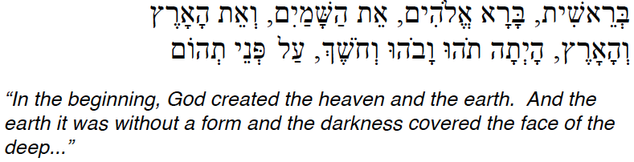
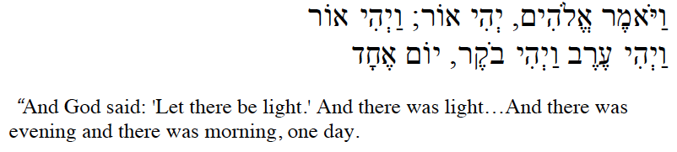
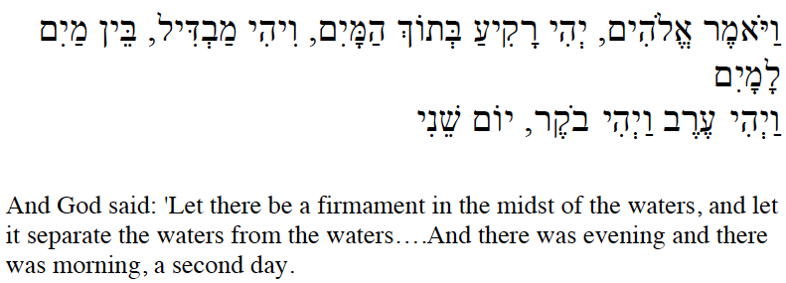
The tie to the first creation story in Bereshit is striking
Very hot, dense universe, disordered
Photons take over within ~1 s
Primordial matter condenses into H & He

Slide 20
But a sympathetic reading does not give the Biblical story more credibility
A scientific view requires one to be skeptical of perceived correlations
The biblical narrative – with its contradictions and difficulties with interpretation – should not be confused with scientific evidence
But the scientific and biblical account speak to desire to understand our world
A scientific approach requires commitment to
  Collect evidence (objectively!)
  Independent replication
  Develop model (theorize)
  Then repeat

Slide 21
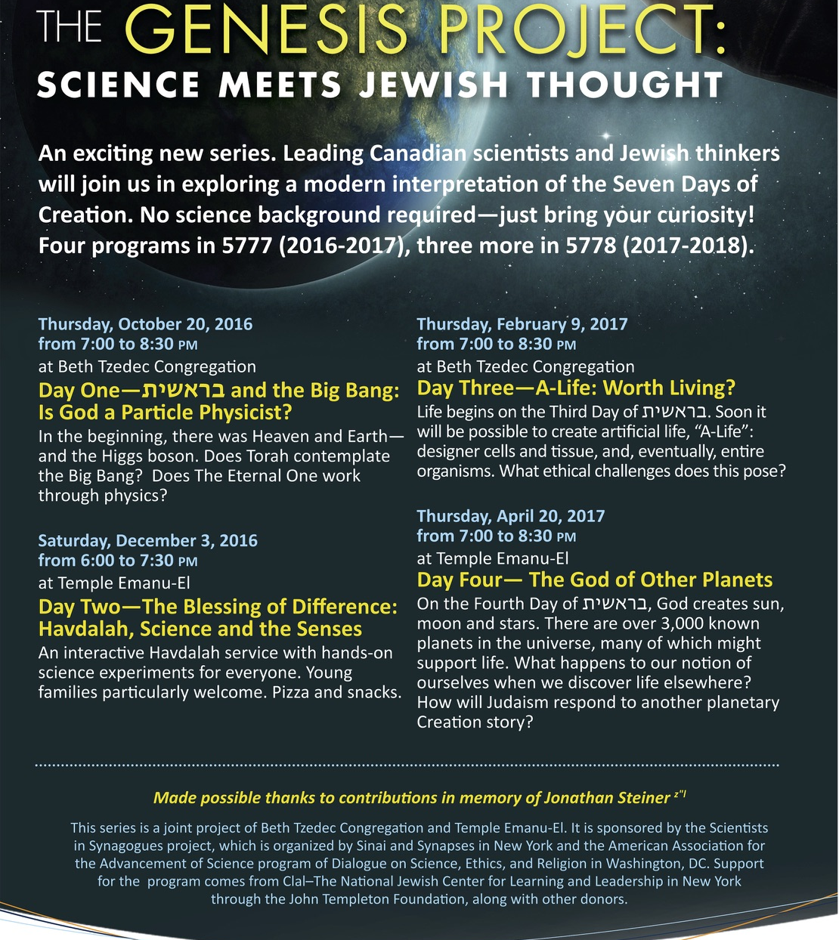
The parallel does provide a framework for discussion about the relationship

Slide 22
I have my own personal views on the relationship between science and Judaism
I am in awe of the world we live in.
I am deeply engaged in understanding our world.
I understand the power that the practice of science brings to this task.
I recognize our universe has mysteries that science—as we practice it—may never unravel.
The study of Torah reveals elements of who I am beyond my identity as a scientist.
Judaism provides me with a structure that allows me to safely think about what I don’t know.
It gives me a language and framework to understand and value my human relationships, both intimate and casual.

Slide 23
Of course, there are a host of metaphysical questions that I have avoided, but are relevant.
Was the universe created ex nihilo?
Why something from nothing?
Is there only one universe, or are we part of a larger “multiverse” scenario?
How do we understand the success of quantum mechanics—with its “spooky action at a distance”?

